Slide 1

Charan Reddy Tamma
Sasank Chithirala
Wendy Claros Barrientos
Yi Wei
Hannah Le
GBUS 721
George Mason University

Slide 2
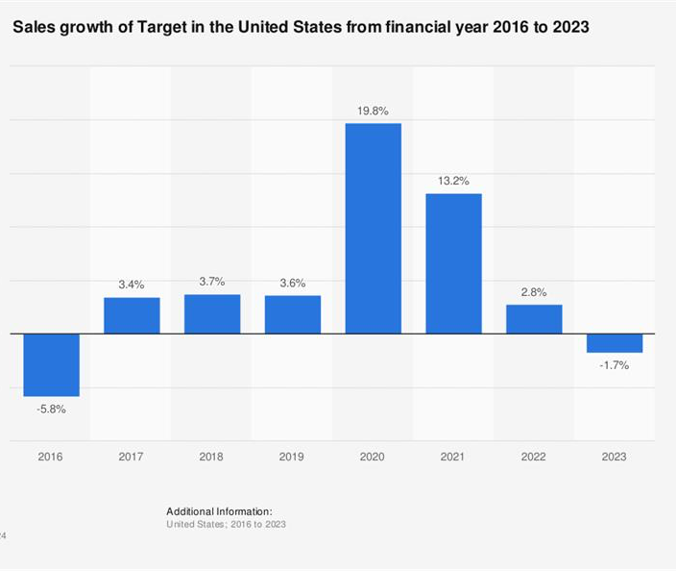
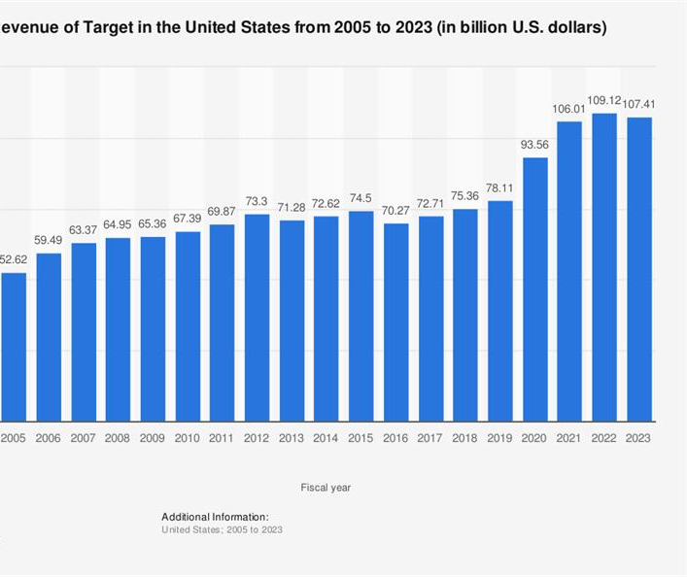
Why did Target face a drop in sales growth since 2020?

Slide 3

Research Design
Quantitative Data Collection: Use sales reports, financial statements, market share data, and consumer spending trends. Conduct surveys with structured questions to gather numerical data.
Data Analysis: For quantitative data, use statistical methods to identify patterns and trends.
Hypothesis Testing: Analyze the data to confirm or refute your initial hypotheses about the reasons for Target's sales decline.

Slide 4

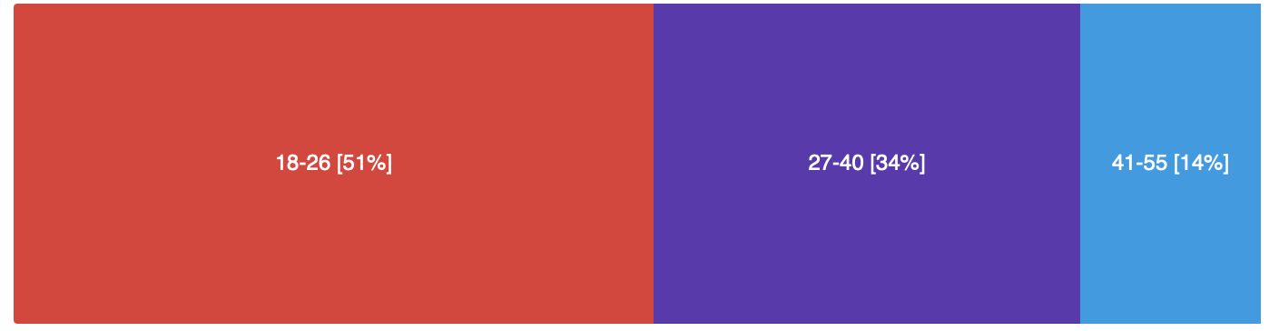
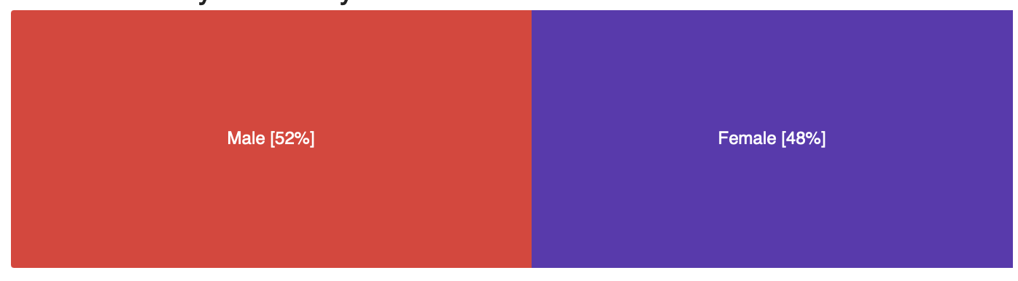
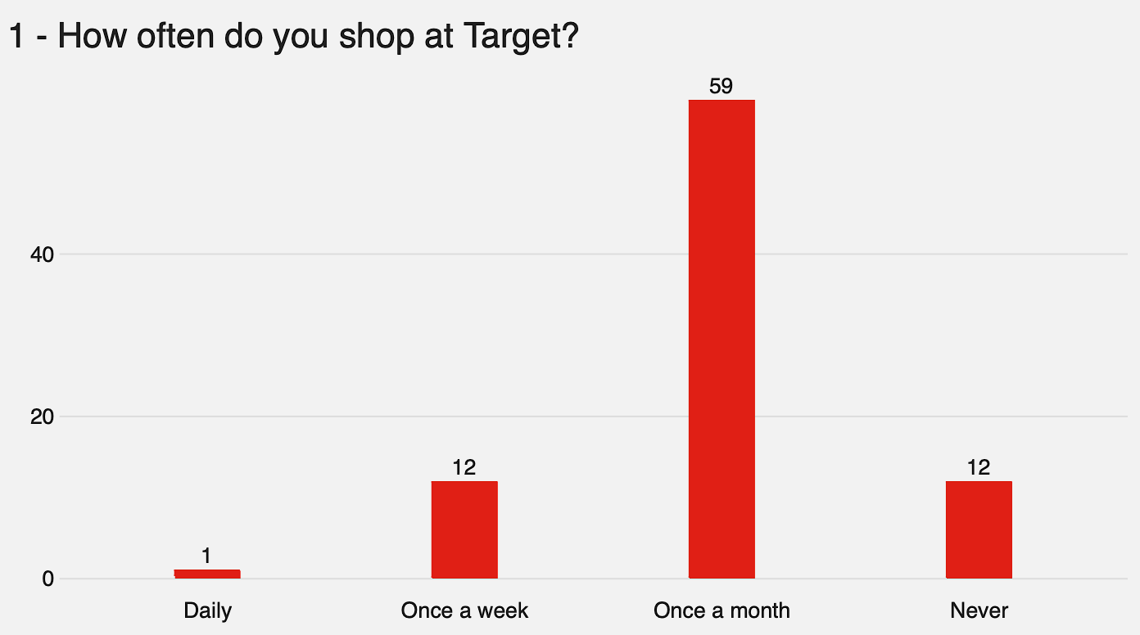

Data sample description
- 101 Responses (March 27 till April 30)
16 questions with 2 demographic questions and 14 questions directly about Target.

Slide 5



Problem Description
Company | Company preference based on PRICE
Walmart | 33
Amazon | 27
Target | 15
Total | 75
Use of RedCard | Count of people who use Red Card
Definitely not | 21
Probably not | 16
Might or might not | 17
Sometimes yes | 17
Definitely yes | 8
Total | 79
H1:
H1:
Company | Company preference based on PRODUCT VARIETY
Amazon | 43
Target | 21
Walmart | 14
Total | 78

Slide 6
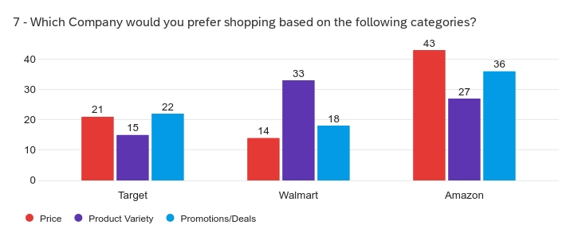
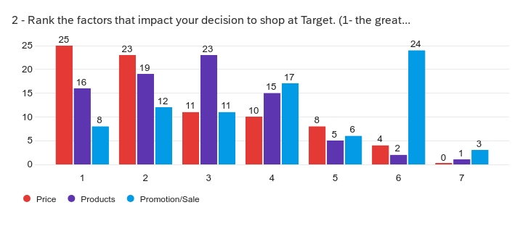
Pricing: What factors do respondents care the most when shopping?

Slide 7
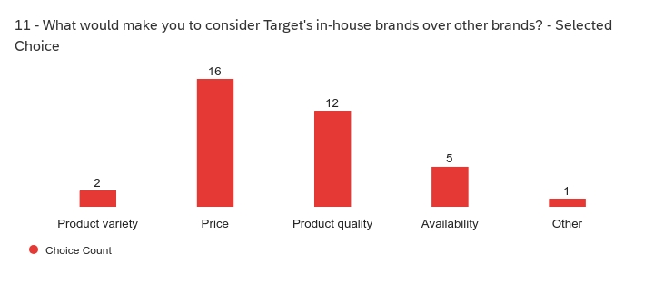
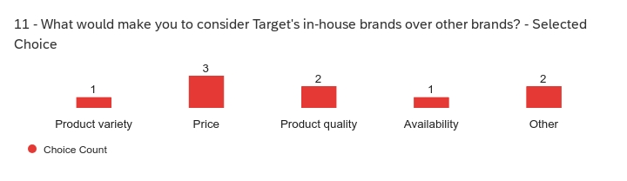
No
Maybe

Slide 8
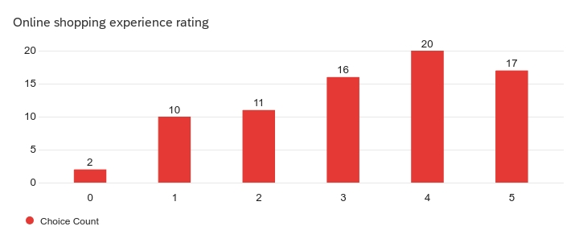
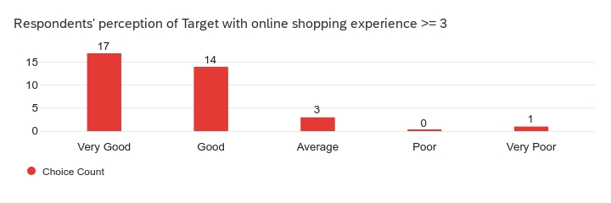
Online platform: Does online shopping somehow increase respondent's satisfaction?

Slide 9
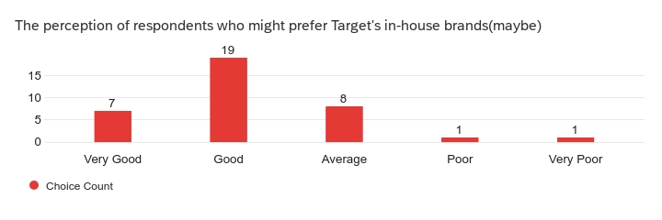
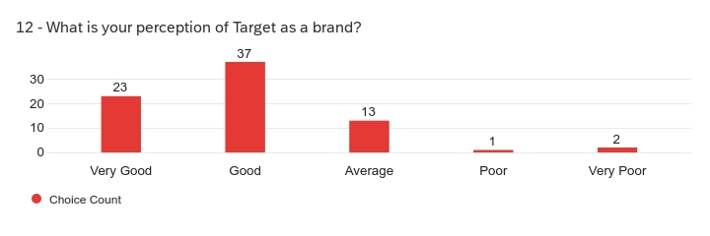
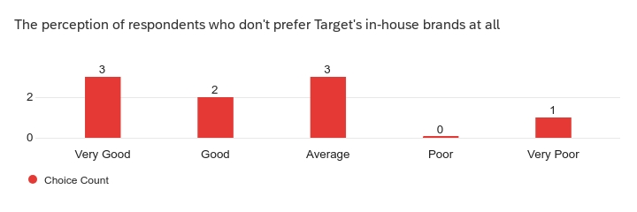
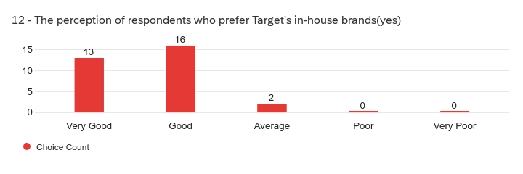
Perception: Respondent’s perception vs. in-house brands

Slide 10
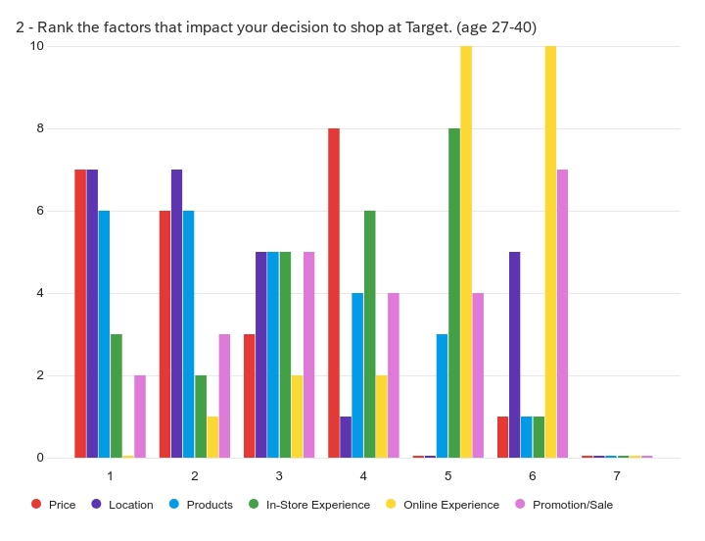
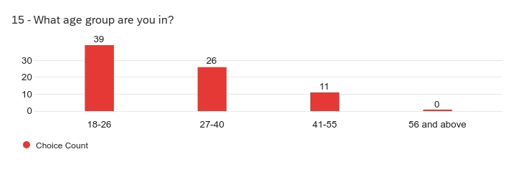
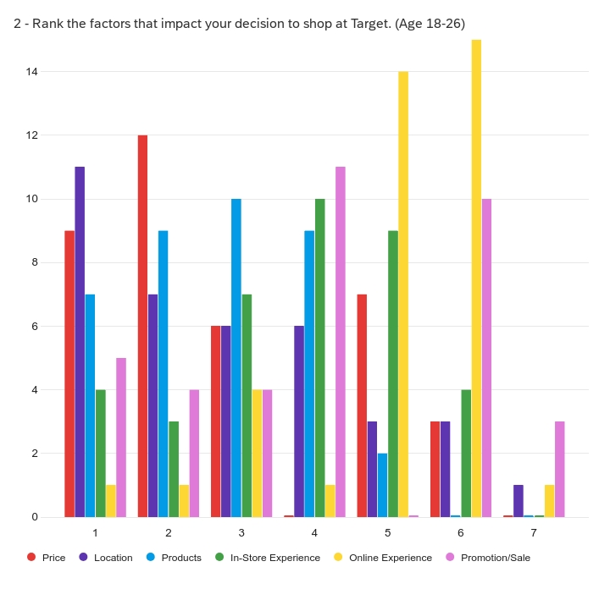
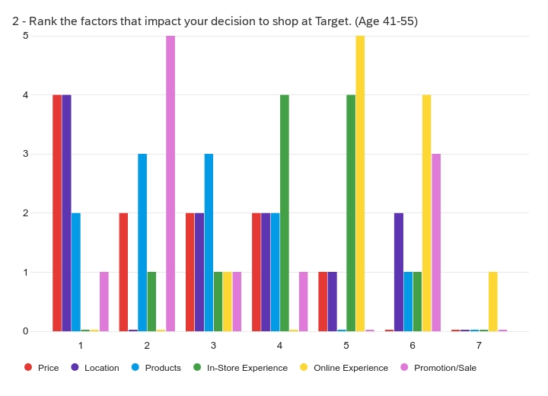
Demographic differences： Factors that affect respondent’s shopping decision at Target vs. Age

Slide 11

Recommendations

Slide 12
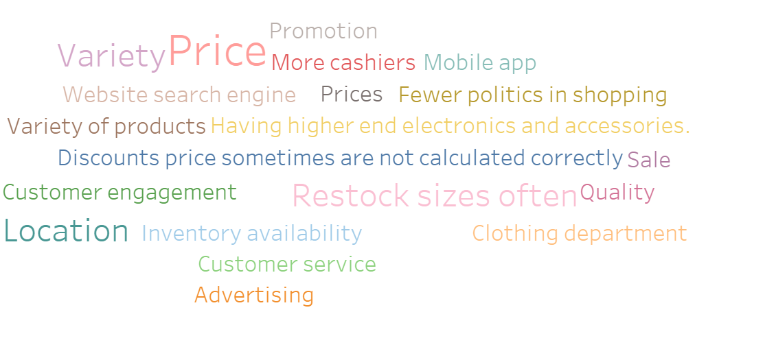

Slide 13
Aggressive Pricing and Exclusive Partnerships
Target should adopt an aggressive pricing strategy to attract price-sensitive customers and increase its market share. Enhancing product variety can meet a broader range of consumer needs and preferences. Additionally, forming partnerships with reputable companies to launch exclusive product versions can differentiate Target from competitors, enhancing its brand as a unique shopping destination and potentially increasing customer loyalty and sales.
Enhancing Variety in In-House Brands
Target's in-house brands would benefit from an expanded and diversified product lineup. This approach caters to a wider array of consumer preferences, maintaining interest and enhancing satisfaction. Ensuring consistent stock availability is crucial to prevent sales losses to competitors due to out-of-stock issues. This strategy will strengthen the appeal of Target’s brands and encourage more frequent purchases.
Enhancing the Online Shopping Experience
While Target's online shopping experience is generally positive, there is room for improvement to compete with platforms like Amazon. Expanding the online product range and ensuring consistent availability are key. Additionally, promoting the website and mobile app can attract a larger customer base. Improving the online interface and navigation will make shopping more intuitive, and increased marketing can drive traffic and conversions, helping Target appeal to convenience-focused shoppers.
Demographic Match and Customer Preferences
Target should consider opening more stores in regions where there is a high density of its core demographic that values the aspects where Target is strong, such as product variety and quality of in-house brands. Areas with a higher middle-income bracket, families, and tech-savvy consumers who might prefer shopping both online and in-store could be ideal.

Slide 14
LIMITATIONS
Potential Response Bias: Since the survey was distributed among personal networks, there could be a response bias, as respondents who have a personal connection to the surveyors might answer questions in a way, they believe would be favorable or supportive.
Lack of Qualitative Data: The project heavily relies on quantitative data. Including qualitative research could provide deeper insights into customer perceptions and motivations that numbers alone cannot capture.
Small Sample Size: The survey collected only 101 responses, which may not be sufficient to draw statistically significant conclusions about a large customer base like Target’s.

Slide 15
Summary
The project focuses on understanding the factors contributing to Target's sales decline since 2020. A mixed-method research design was employed, primarily utilizing quantitative data collected through surveys and financial reports.
The survey, conducted over a short period, gathered 101 responses, emphasizing customer preferences and shopping behaviors at Target. The data was analyzed to test hypotheses related to Target's market share, profitability, product differentiation, and online presence strategies.
The Key findings from the analysis suggest potential areas for strategic improvement in pricing, product offerings, and online sales integration. The project culminates with recommendations for Target to enhance its competitive edge and customer appeal in the retail market.

